Slide 1

WiFi Signal Visualizer
Marcel Bruckner & Julian Hohenadel
Technische Universität München
Fakultät für Informatik
München, 18. Dezember 2018

Slide 2
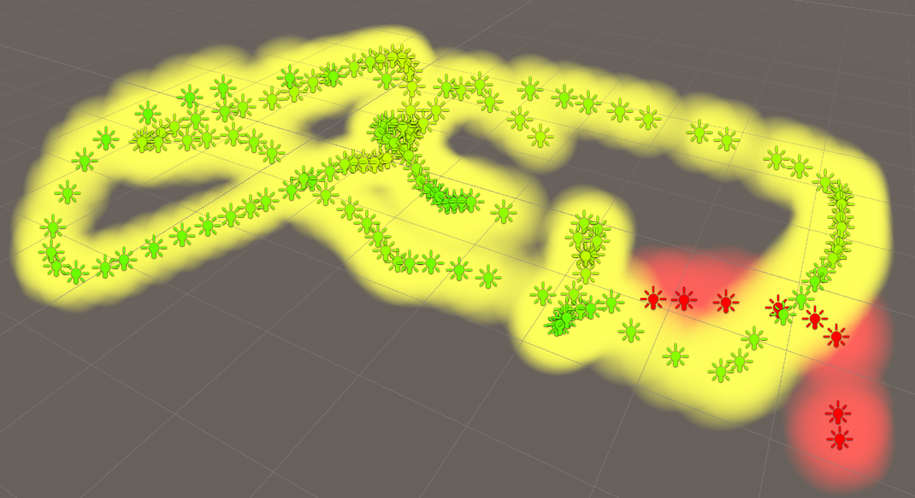
Objective
Create a WiFi Signal Scanner / Visualizer
Position tracking for 3D pose estimation
WiFi tracking for signals and their strength
Visualize the collected data on the HoloLens

Slide 3
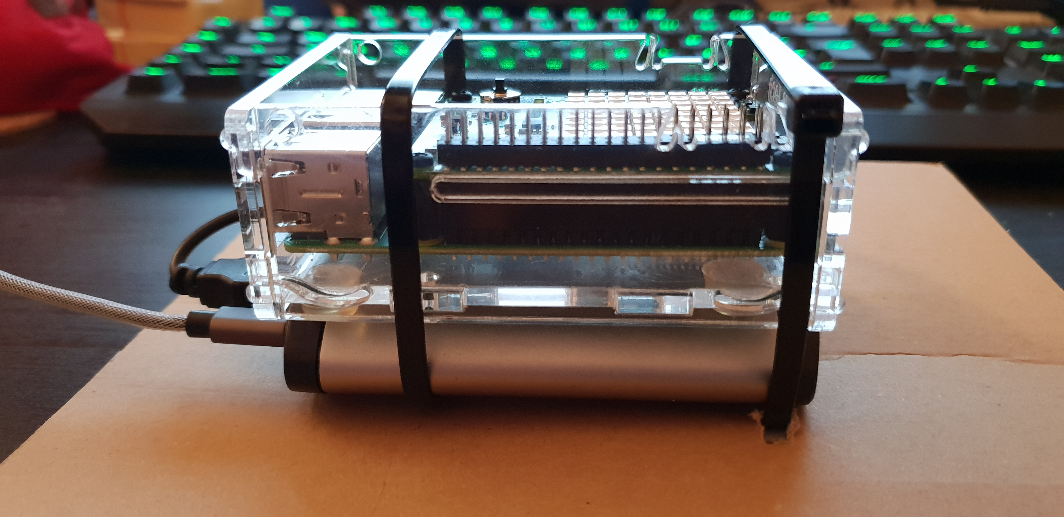
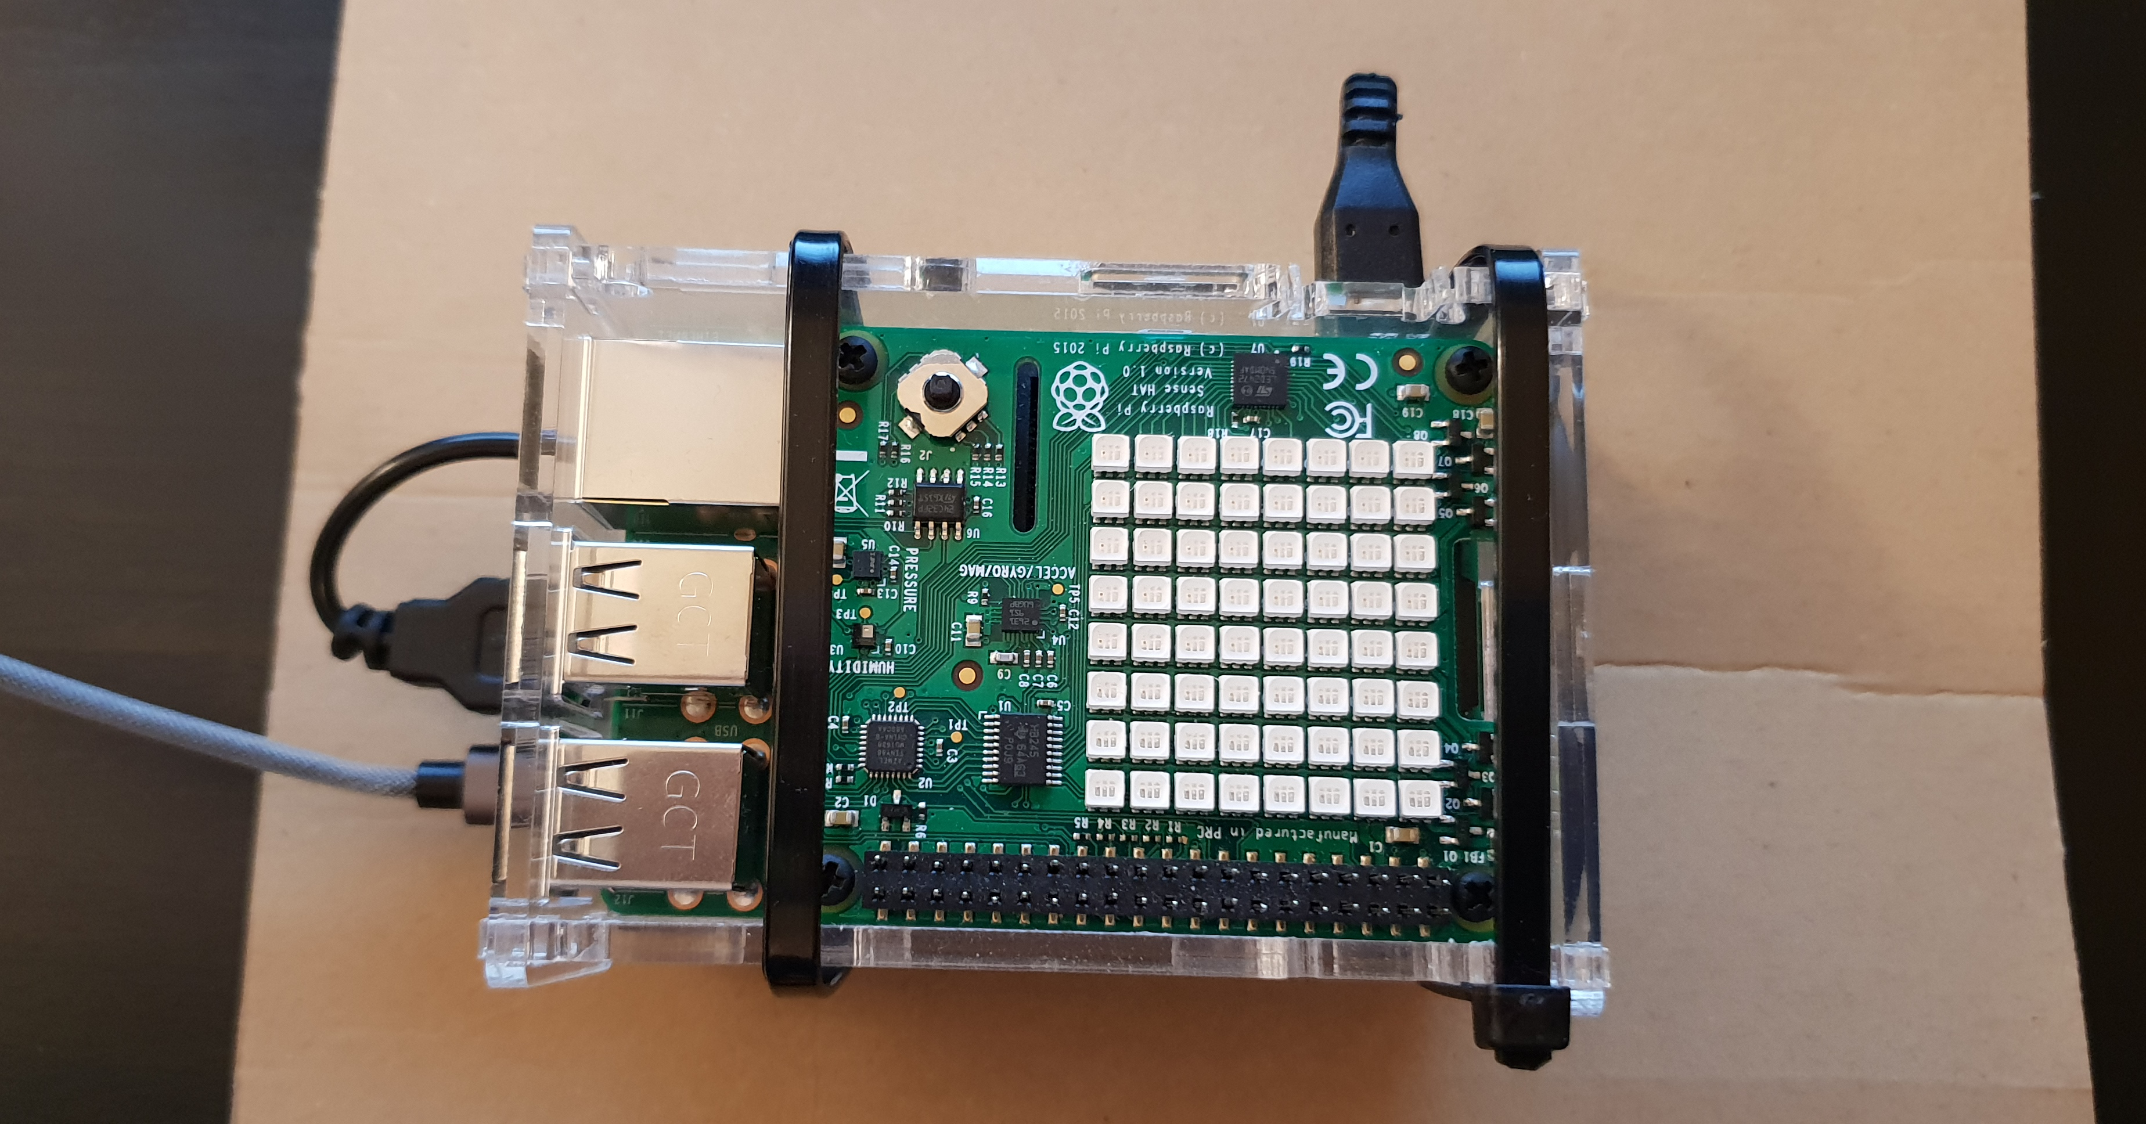
WiFi Signal Scanner
Components used for capturing and tracking the WiFi signal:
Raspberry Pi SenseHat (I/O Device)
Raspberry Pi 3b+ (Multi-devices communication)
Powerbank (Keeps the marker mobile)
Marker (Tracking)

Slide 4
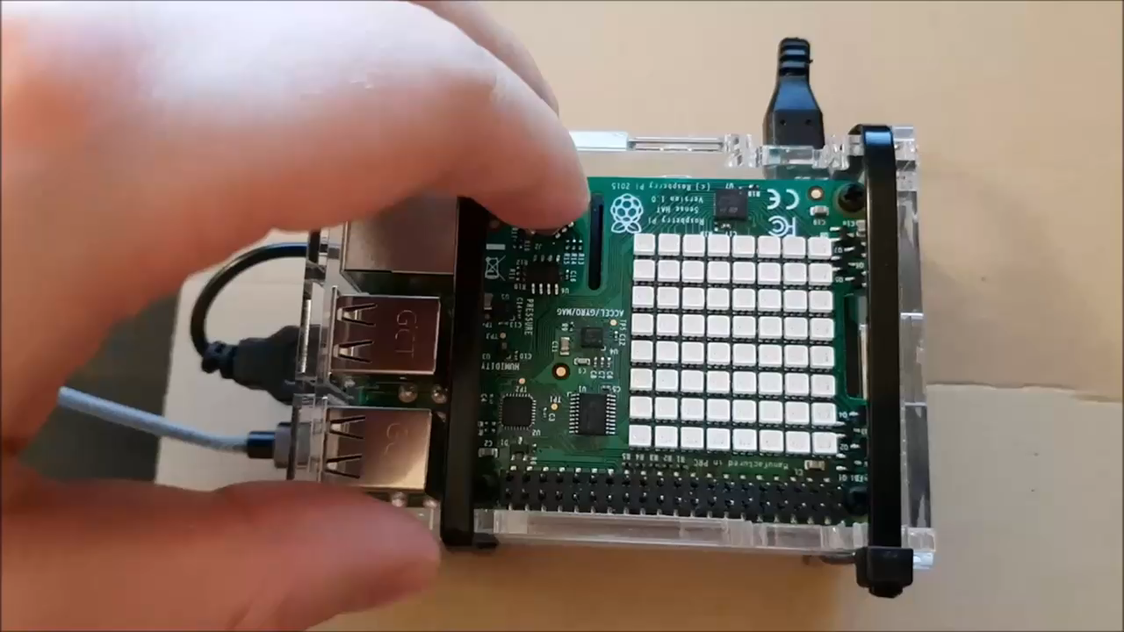
Scanner to Tracker Connection – TCP Script
Startup
Pressing the joystick starts the TCP server
Shows IP address and open port of the device
The green light indicates the device is waiting for a new connection (using TCP)

Slide 5
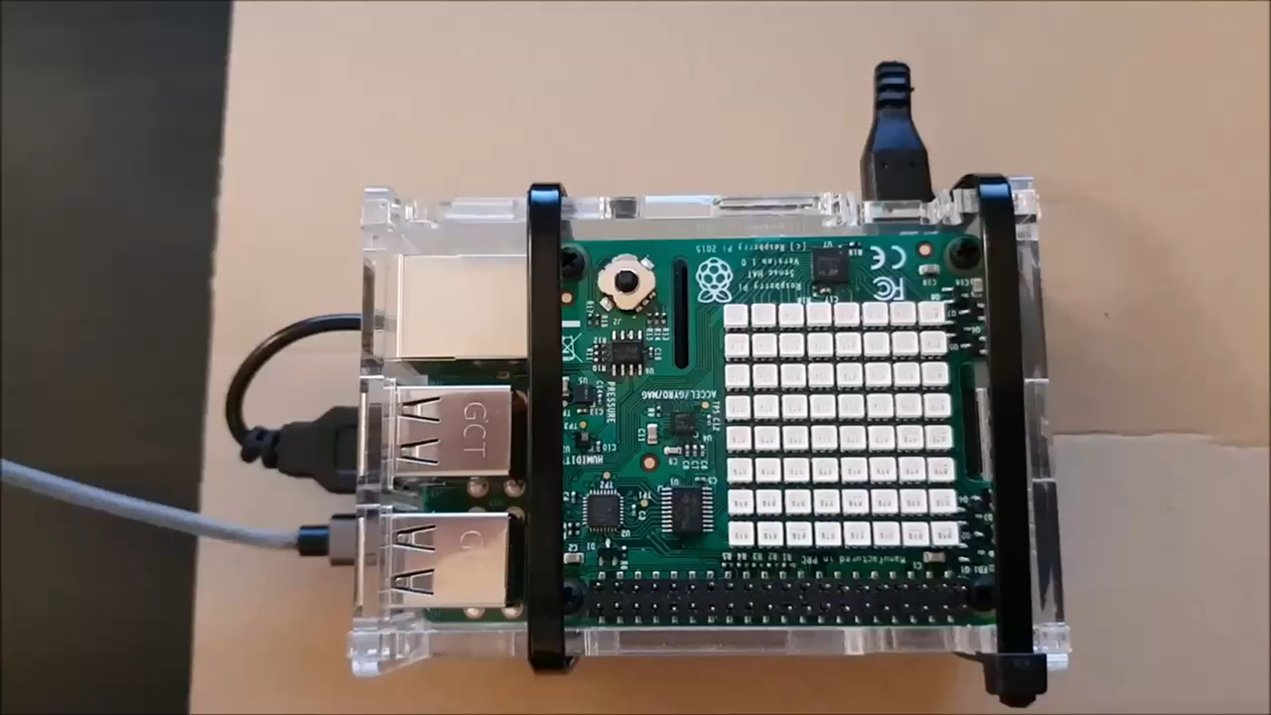
Scanner to Tracker Connection – Connect
Connect
The IP address and the remote port of the connected device is shown in green

Slide 6
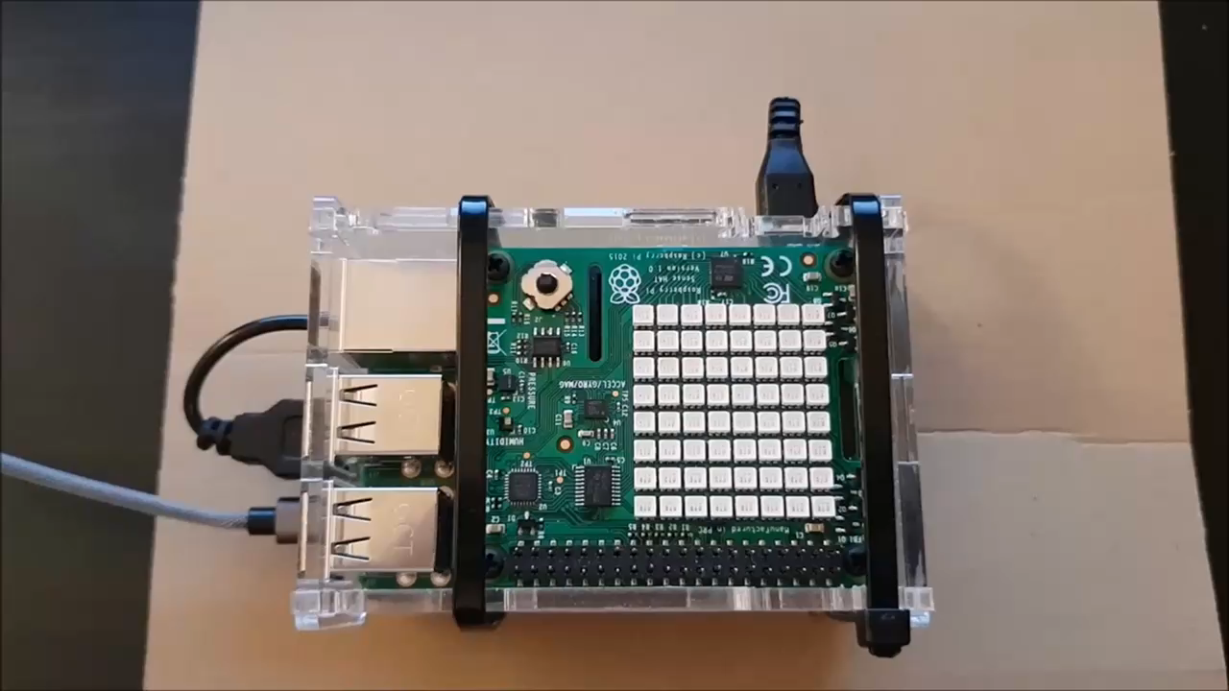
Scanner to Tracker Connection – Disconnect
Disconnect
The IP address and the remote port of the disconnected device is shown in red

Slide 7
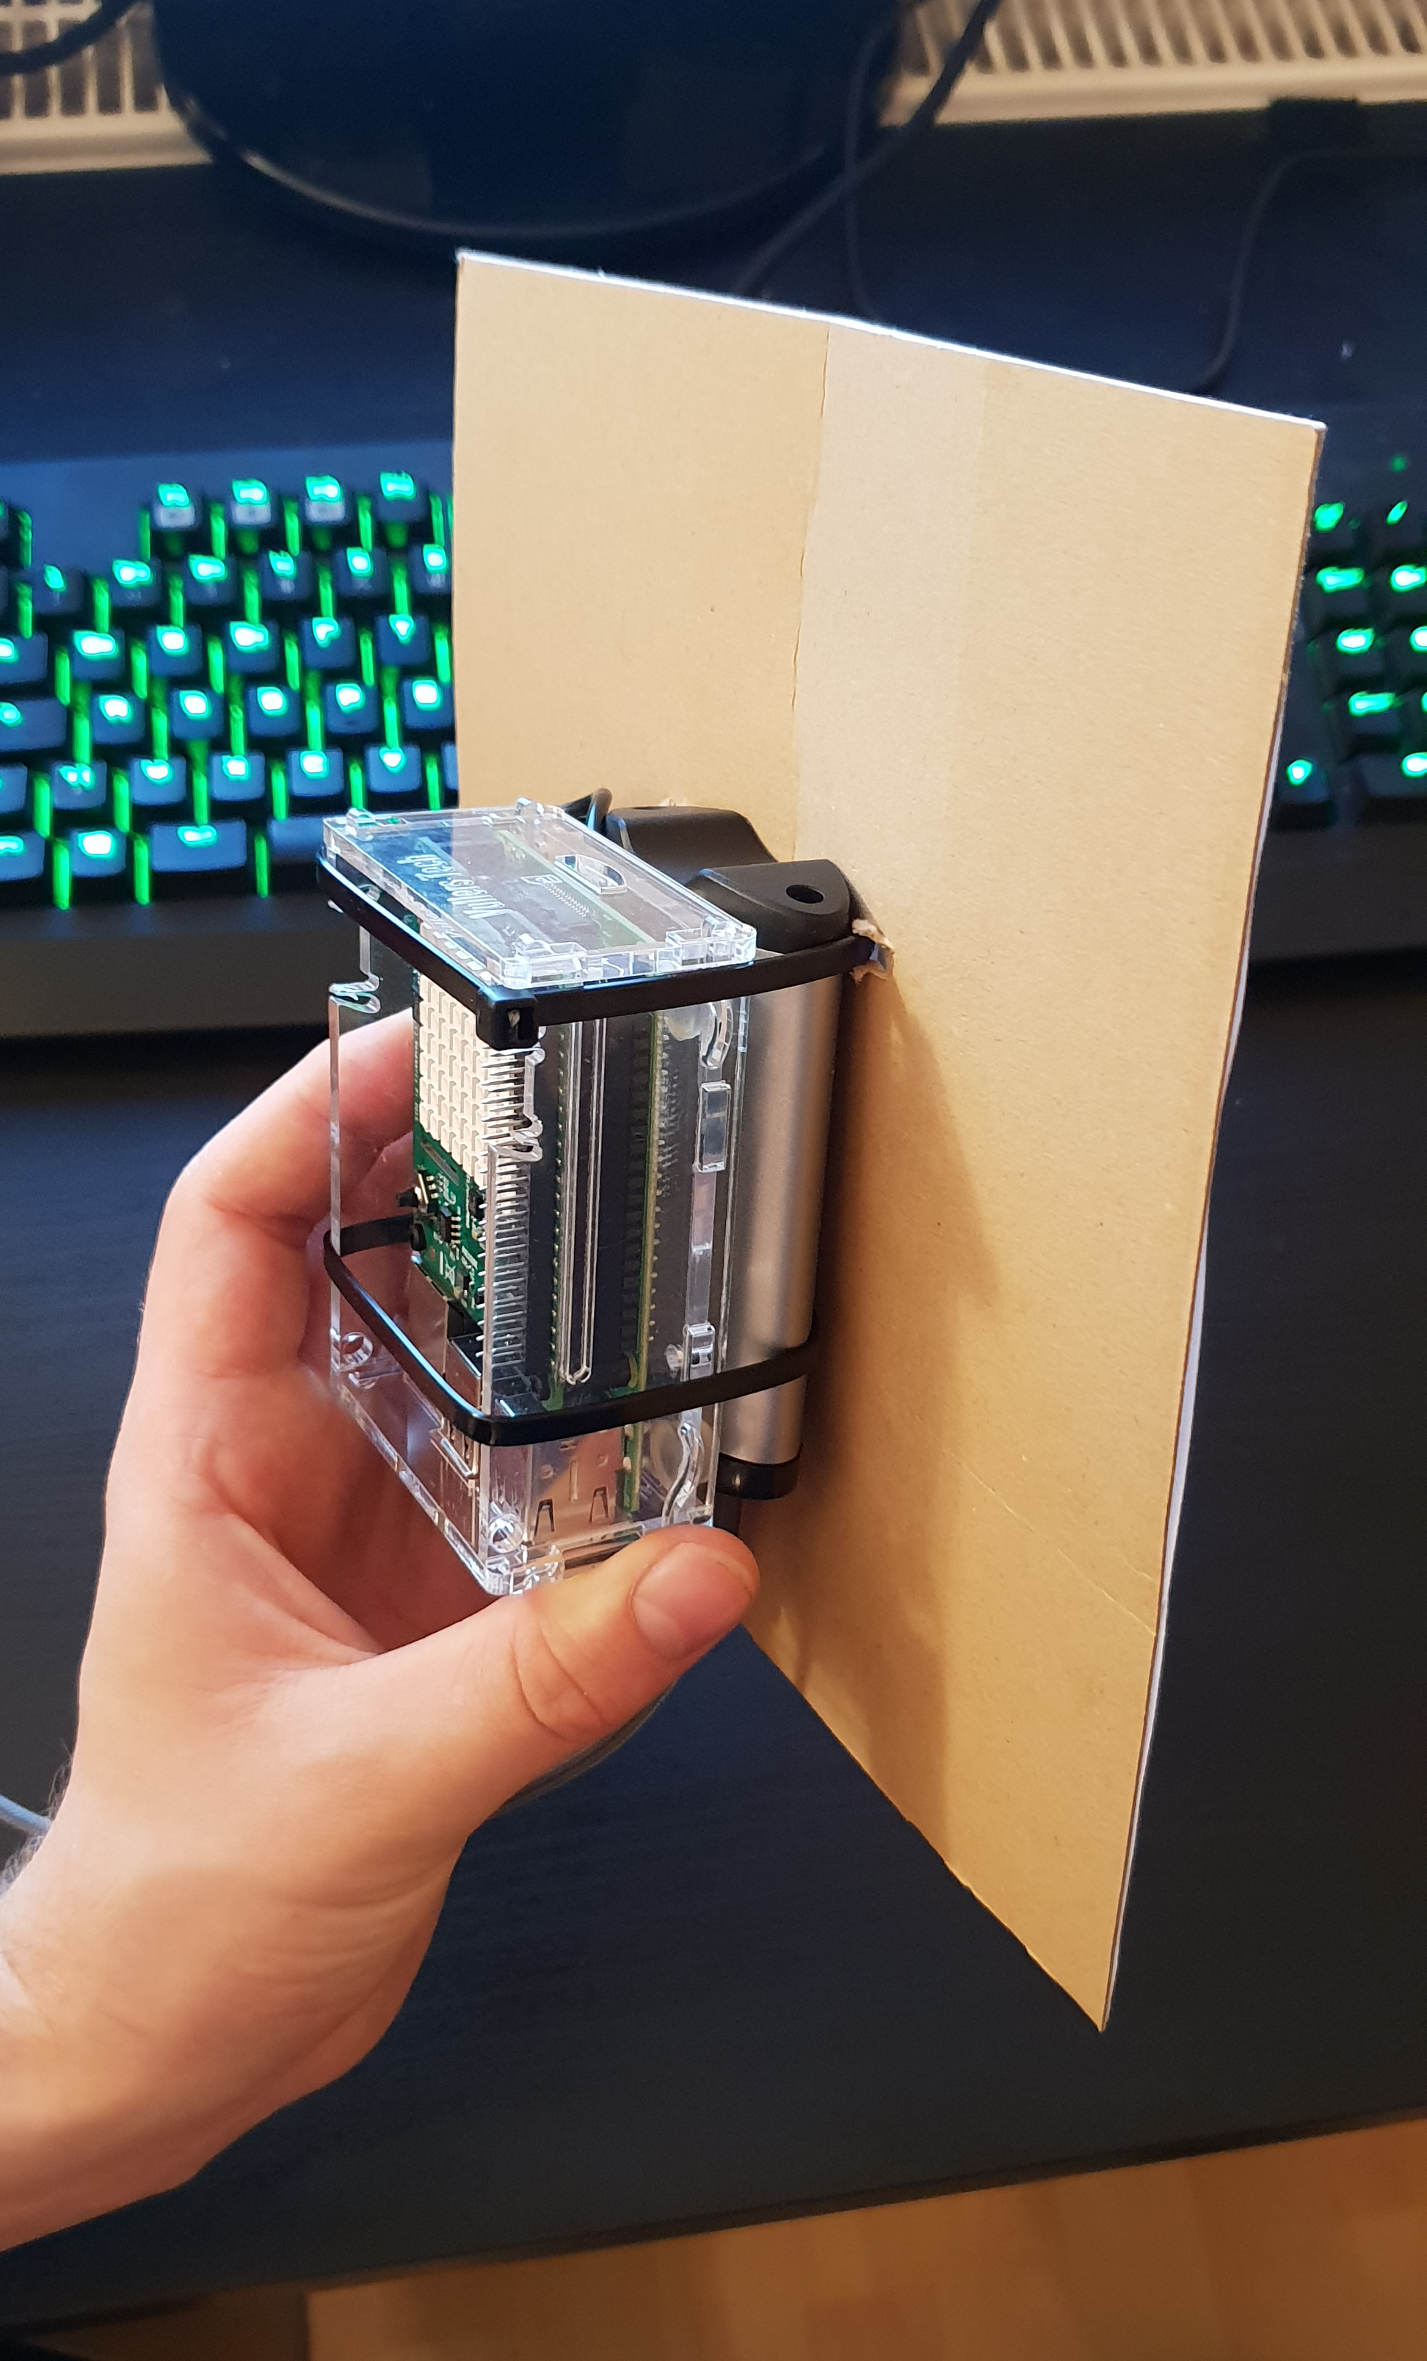
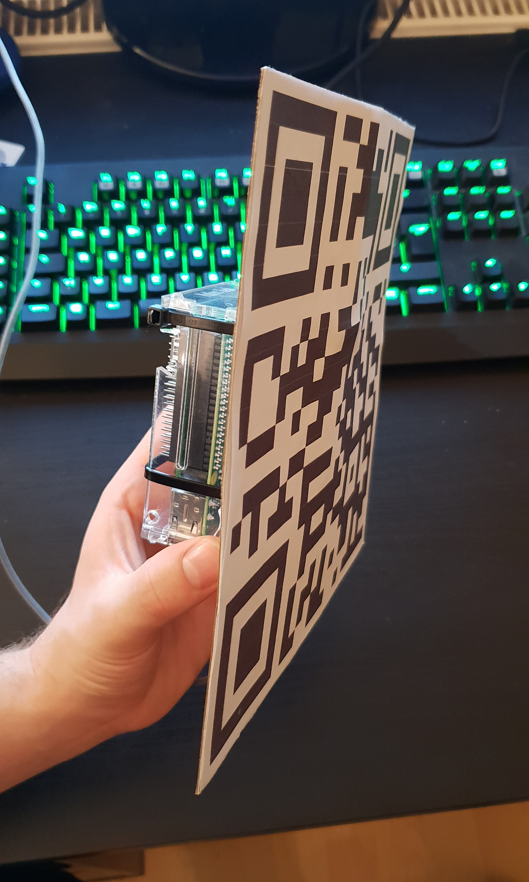

WiFi Signal Tracker
The marker is mounted on the back of the Powerbank

Slide 8
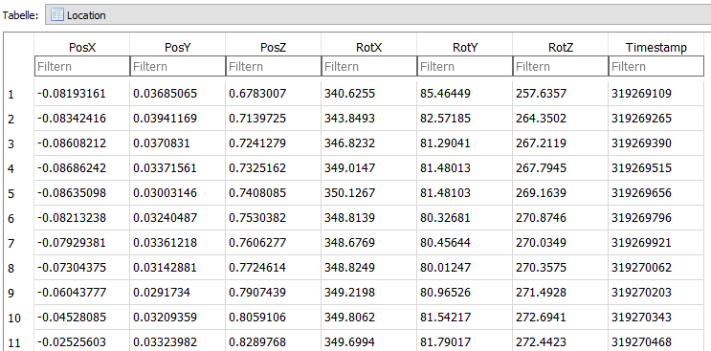
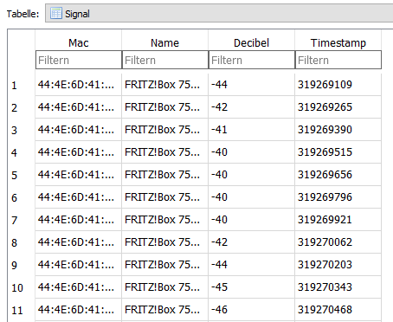
Data storage
The Location Database stores:
Position (X,Y,Z)
Rotation (X,Y,Z)
Timestamp for identification
The Signal Database stores:
MAC Address and SSID of the Router
The WiFi strength in Decibel
Timestamp for identification

Slide 9
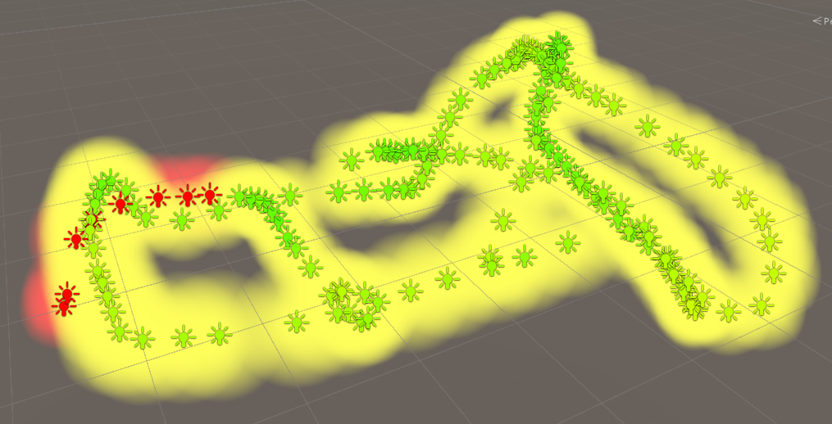
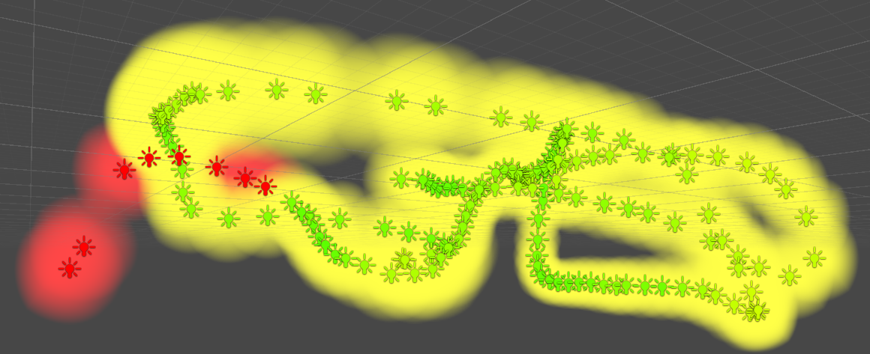
Visualization of the data

Slide 10
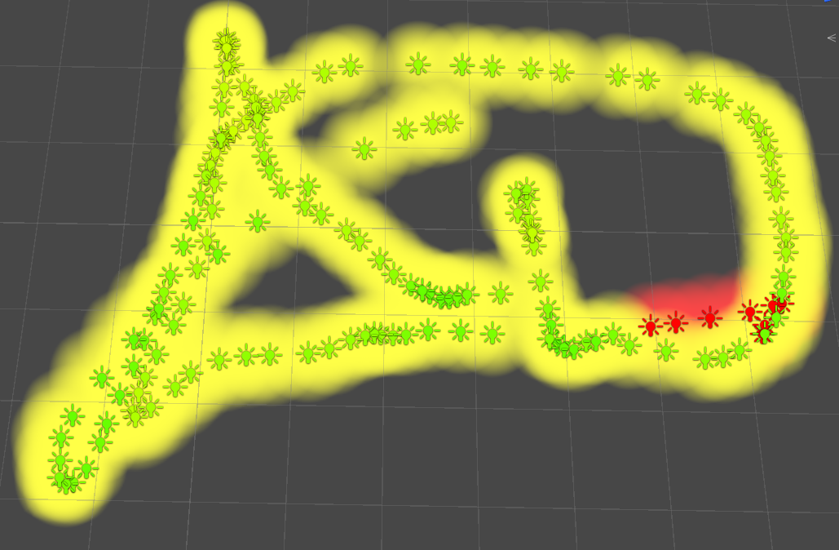
Visualization of the data

Slide 11
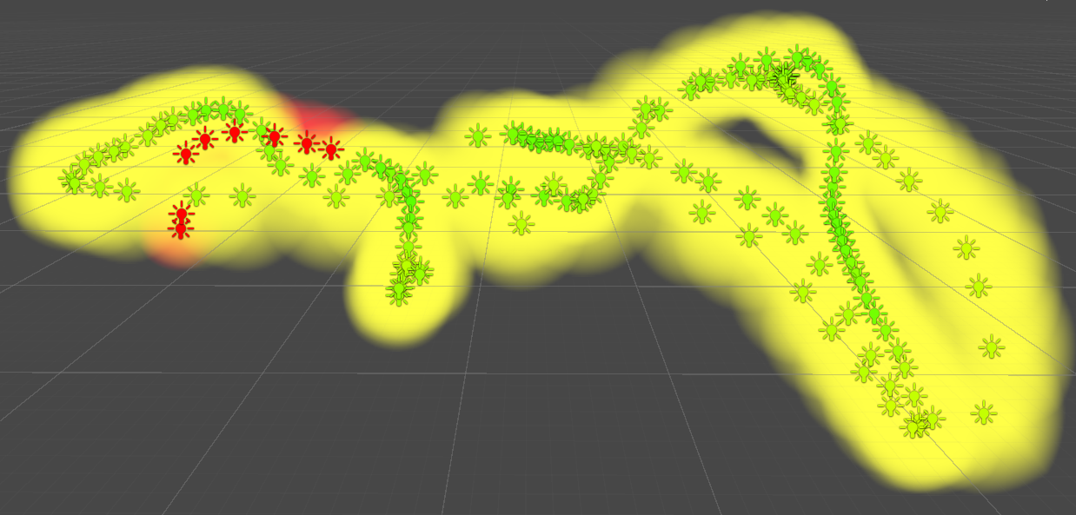
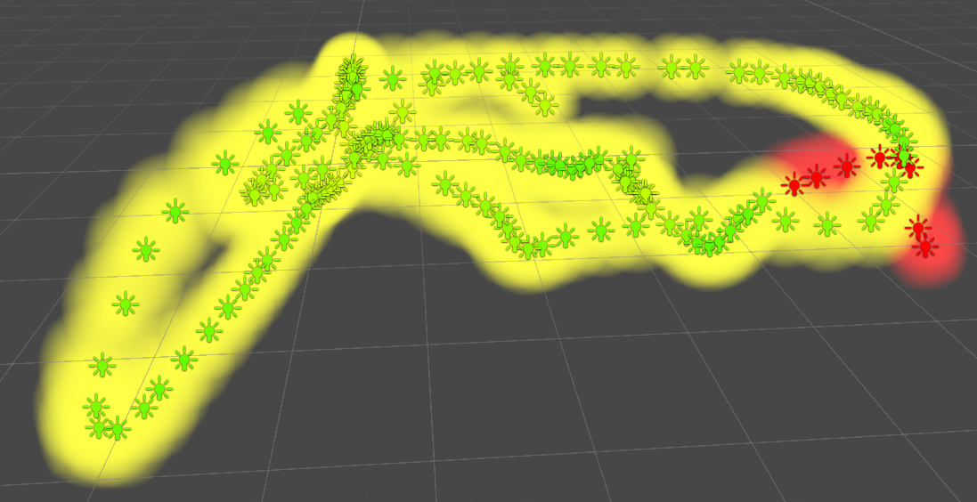
Visualization of the data

Slide 12
Future Work
Use a smartphone for capturing and tracking the WiFi signal strength
Change the signal visualization from Halo Objects to Sphere Object (with a shader) to increase performance

Slide 13
WiFi Signal Visualizer
Create a WiFi Signal Scanner / Visualizer
Position tracking for 3D pose estimation
WiFi tracking for signals and their strength
Visualize the collected data on the HoloLens

